Slide 1
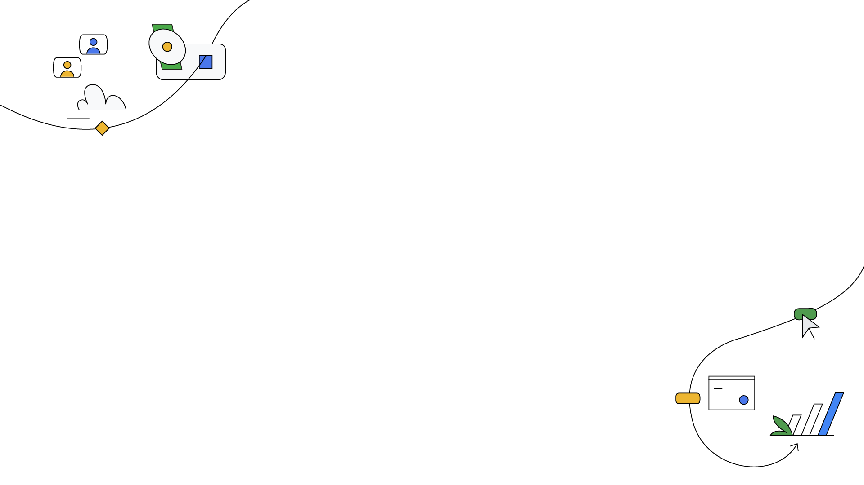

Better Together
Google Kubernetes Engine Threat Detection Powered by Security Command Center
Adebayo Omolumo
Software Developer, Iglumtech
Date: 29/6/24

Slide 2


Agenda
Introduction
GKE Threat Detection
Live Demo
Interactive Discussion

Slide 3

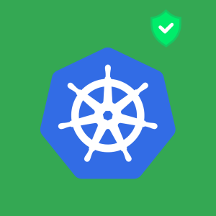

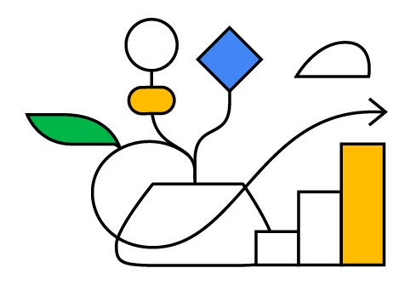
Introduction

Slide 4

Kubernetes is 10 🎉
10
Trivia (Hints)
Borg
K8s
Helmsman or Pilot
years
Source: xxxxx

Slide 5
Kubernetes is 10 🎉
Answers
Born from Google's internal container management system called Borg
Letters in between K and S
"Kubernetes" comes from the Greek word for helmsman or pilot.
10
years
Source: xxxxx

Slide 6
Cloud Security as a Team Sport
Team Sport
Cloud Security
Importance of teamwork, collaboration, and communication from different levels.
Cloud security requires a coordinated effort to build a robust defense against evolving threats.

Slide 7
Key Challenges
Expertise Shortage
Security Complexity
Despite Kubernetes' decade-long existence, finding, training, and retaining skilled Kubernetes and container engineers, especially those with security expertise, remains challenging.
The intricate nature of container technologies and security can hinder organizations' confidence and pace in adopting container-based workloads.

Slide 8

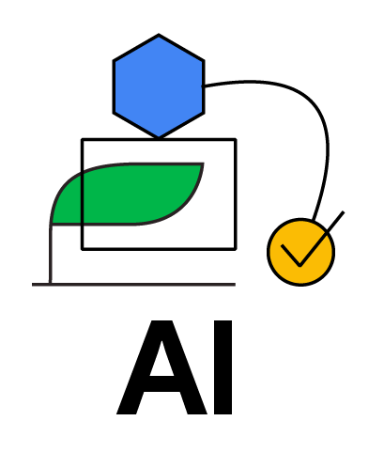
Security Threat Landscape
Financially Motivated Attackers
Direct Kubernetes Attacks
Automation and Education
Initial attacks involved stealing cloud credentials (leaks) for activities like cryptocurrency mining.
As defensive measures improved, attackers shifted to exploiting misconfigured Kubernetes clusters directly
Threat actors are increasingly using automated tools, lowering the entry barrier for other attackers.

Slide 9
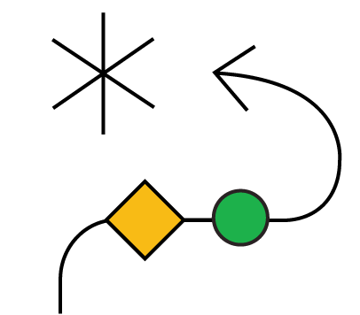
GKE's Security Foundation
GKE offers a mature and secure platform, drawing from Google's extensive experience with Kubernetes. Key security features include
Modern Identity and Access Integrations
Compliance and Security Intelligence
Ensuring robust access controls.
Maintaining high compliance standards and swiftly addressing vulnerabilities.

Slide 10
Integrated Security and Compliance Tools
To enhance security and manage workloads at scale, GKE Enterprise offers:
Runtime Vulnerability Scanning
Integrated Policy Solutions
GKE Compliance
Identifying vulnerabilities in deployed containers.
Enforcing secure configurations and best practices.
Automatically assessing clusters and workloads against CIS Benchmarks.

Slide 11
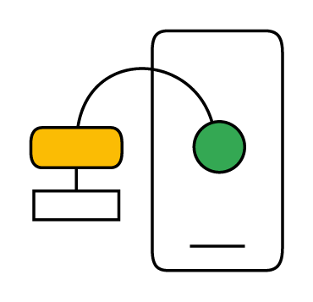
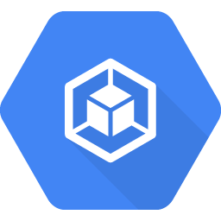
GKE Threat Detection

Slide 12


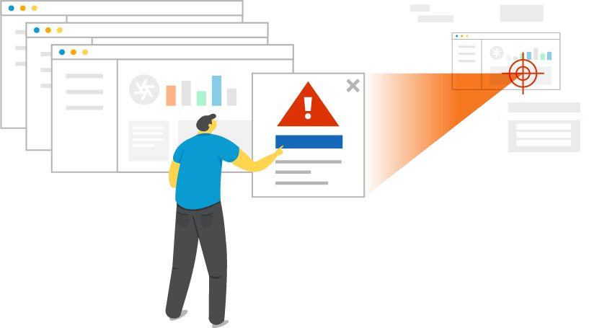




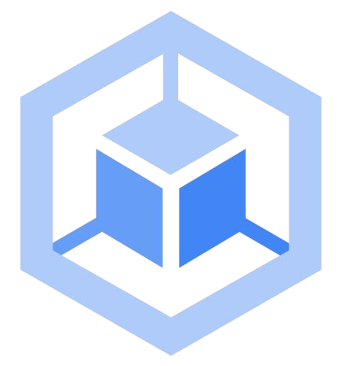




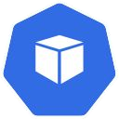
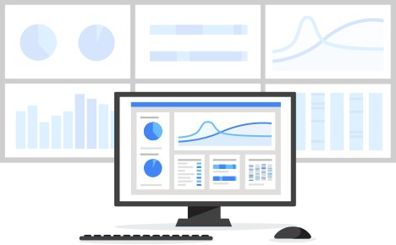

New! GKE Threat Detection
SCC
Threat Detection
GKE Cluster
Cloud Logging
Event Threat Detection
Security and Governance
Control Plane
Threat detector
Cloud Logging
Log Ingestion
Threat detector
GKE
Threat detector
Container Workloads
Threat detector
Security Posture
Platform and Operations
010

Slide 13
GKE threat detection integrated with Security Command Center (SCC)
Event-Based Threat Detection (ETD)
Integrated Security Approach
Integrated with GKE Enterprise
Uses Kubernetes audit logs and Cloud Logging
Supports multiple security teams
Central Security and Governance Teams
Platform Teams

Slide 14
GKE threat detection integrated with Security Command Center (SCC) Contd.
Near Real-Time Detection
Threat Detection Framework
Continuous log analysis and quick threat detection
Based on MITRE ATT&CK framework

Slide 15


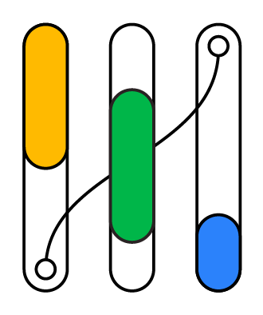
Live Demo

Slide 16
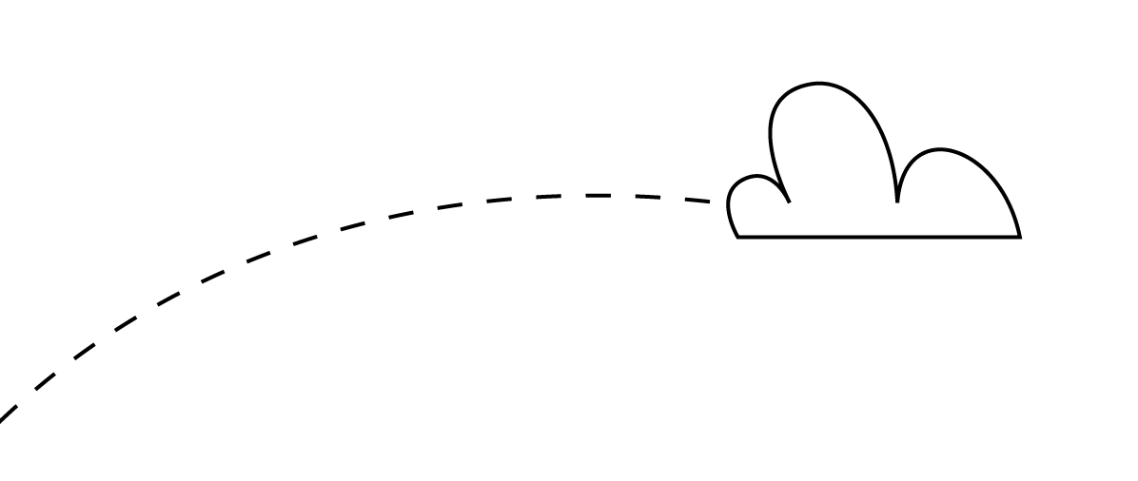
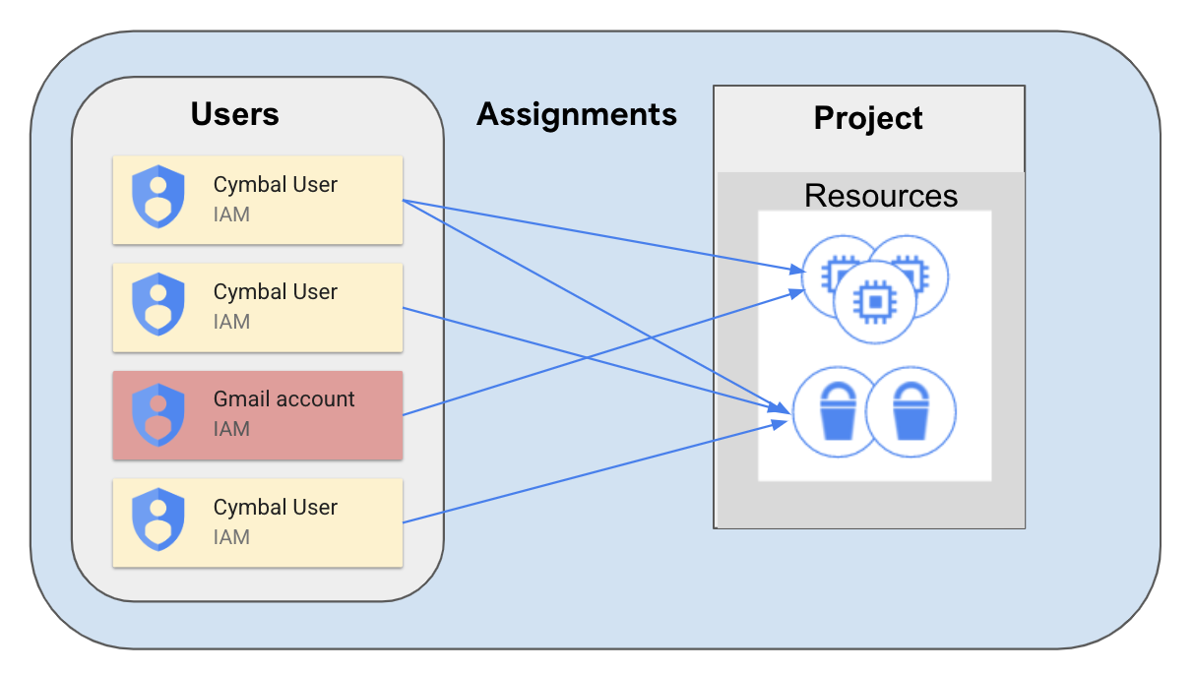

Initiate and mitigate a threat with Event Threat Detection
Mitigate non-compliant accounts threats with Event Threat Detection (Non org IAM member & IAM anomalous grant).

Slide 17
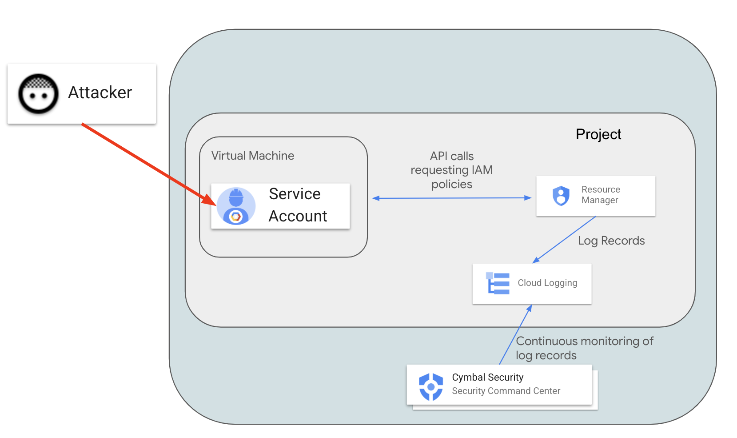
Configure a cloud environment to detect threats
By enabling additional data access logs from Resource Manager Admin Read logs and Cloud DNS Logs.

Slide 18
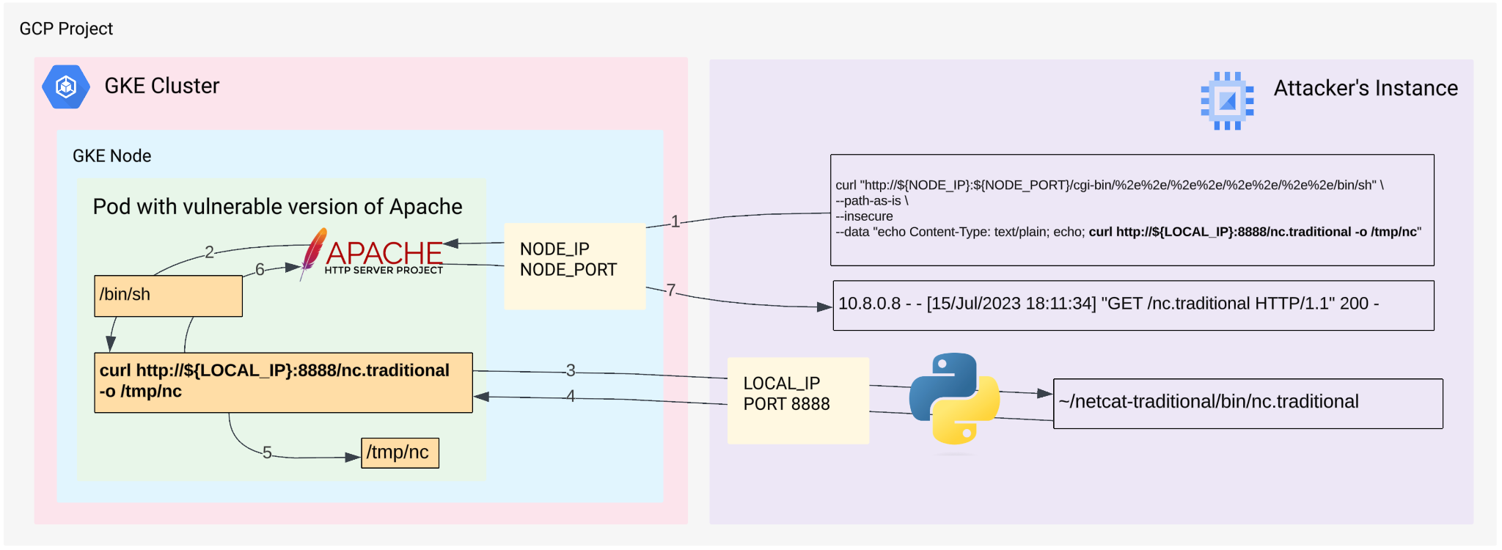
Exploit a web server and detect issues with Container Threat Detection
Build an environment for detecting container threats first and then exploit vulnerable web server.

Slide 19
Threat Response Lifecycle
Detect
Receive a threat detection alert.
Contain
Stop further exploitation
Prevent
Stop similar misconfigurations
1st
2nd
3rd
4th
5th
Analyze
Review the affected resources.
Eradicate
Remove all malicious workloads and
bindings.

Slide 20

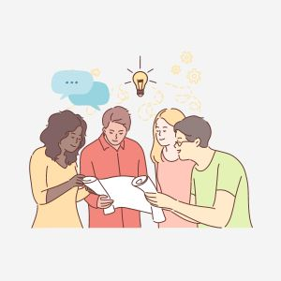

Interactive Discussion

Slide 21
Thank You!

